Slide 1
Material for this lecture has been taken from:

Slide 2
Quality control problem
A lightbulb manufacturer produces approximately a half million bulbs per day. The quality control department must monitor the defect rate of the bulbs. It can accomplish this task by testing each bulb, but the cost would be substantial and would greatly increase the price per bulb. An alternative approach is to select 1000 bulbs from the daily production of 500000 bulbs and test each of the 1,000. The fraction of defective bulbs in the 1000 tested could be used to estimate the fraction defective in the entire day’s production.
Investigating dependencies
To investigate the claim that people who quit smoking often experience a subsequent weight gain, researchers selected a random sample of 400 participants who had successfully participated in programs to quit smoking. The individuals were weighed at the beginning of the program and again one year later. The average change in weight of the participants was an increase of 2.6 kg. The investigators concluded that there was evidence that the claim was valid.
Data selection
For a study of the effects of nitrogen fertilizer on wheat production, a total of 15 fields were available to the researcher. She randomly assigned three fields to each of the five nitrogen rates under investigation. The same variety of wheat was planted in all 15 fields. The fields were cultivated in the same manner until harvest, and the number of pounds of wheat per acre was then recorded for each of the 15 fields. The experimenter wanted to determine the optimal level of nitrogen to apply to any wheat field, but of course, she was limited to running experiments on a limited number of fields. After determining the amount of nitrogen that yielded the largest production of wheat in the study fields, the experimenter then concluded that similar results would hold for wheat fields possessing characteristics somewhat the same as the study fields. Is the experimenter justified in reaching this conclusion?

Slide 3
The mode of a set of measurements is defined to be the measurement that occurs most often (with the highest frequency).
Amount of food (in g) eaten by dogs of the weight of 5.0-5.2 kg per week
962 1005 1033
980 965 1030
975 989 955
1015 1000 970
1042 1005 995
The median of a set of measurements is defined to be the middle value when the measurements are arranged from lowest to highest.
Each of 10 children in the second grade was given a reading aptitude test. The scores were as follows:
95 86 78 90 62 73 89 92 84 76
Determine the median test score
An experiment was conducted to measure the effectiveness of a new procedure for pruning grapes. Each of 13 workers was assigned the task of pruning an acre of grapes. The productivity, measured in worker-hours/acre, is recorded for
each person.
4.4 4.9 4.2 4.4 4.8 4.9 4.8 4.5 4.3 4.8 4.7 4.4 4.2
Determine the mode and median productivity for the group.

Slide 4
median for grouped data
Chicken weight
The interval for which the cumulative relative frequency exceeds 0.5
The median of a set of measurements is defined to be the middle value when the measurements are arranged from lowest to highest.

Slide 5
The arithmetic mean, or mean, of a set of measurements is defined to be the sum of the measurements divided by the total number of measurements
overdue accounts in a department store (in EUR):
55.20 4.88 271.95
18.06 180.29 365.29
28.16 399.11 807.80
44.14 97.47 9.98
61.61 56.89 82.73

Slide 6
The pth percentile of a set of n measurements arranged in order of magnitude is that value that has at most p% of the measurements below it and at most (100 p)% above it.
The interquartile range (IQR) of a set of measurements is defined to be the difference between the upper and lower quartiles

Slide 7
Median,
mean,
variance,
standard deviation
The median of a set of measurements is defined to be the middle value when the measurements are arranged from lowest to highest.

Slide 9
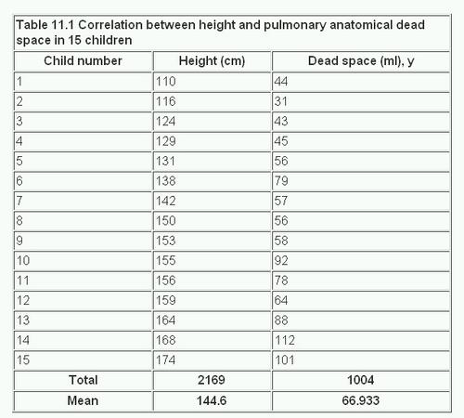
Correlation coefficient
https://www.bmj.com/about-bmj/resources-readers/publications/statistics-square-one/11-correlation-and-regression

